Slide 1

Marketing Plan HomePOV
Group Members :
Syed Muhammad Mashood (20B-084-CS)
Muhammad Samiullah Siddiqui (20B-007-CS)
Huda Nasir(20B-086-CS)

Slide 2

Brand Logo :

Slide 3
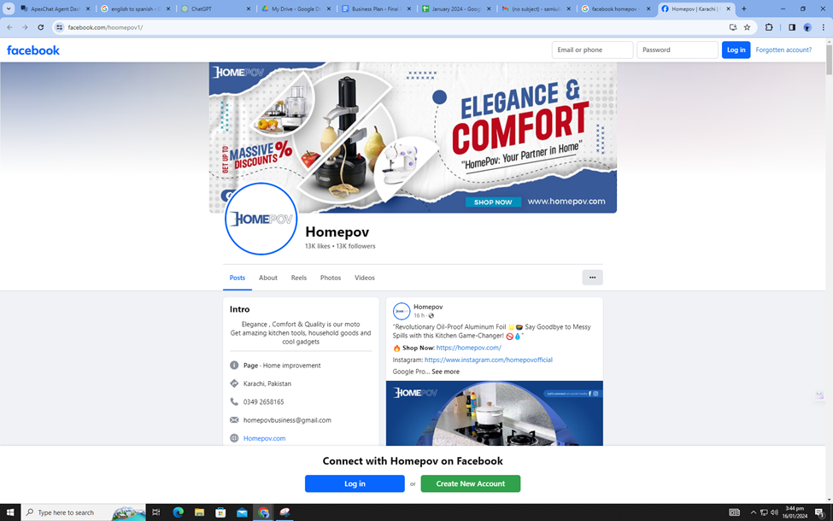
Facebook Page https://www.facebook.com/hoomepov1/

Slide 4
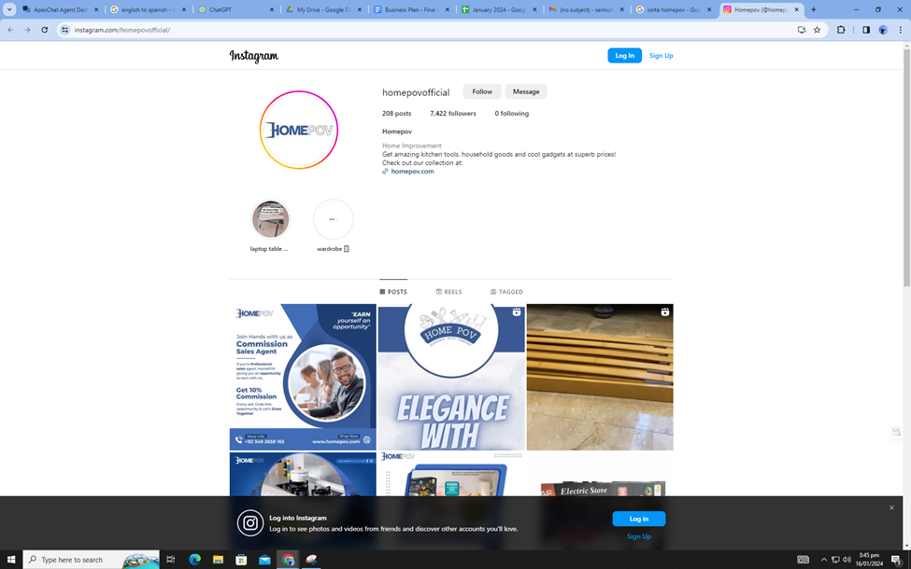
Instagram Page https://www.instagram.com/homepovofficial?igsh=NnZoYmwwaXdyZG9x

Slide 5
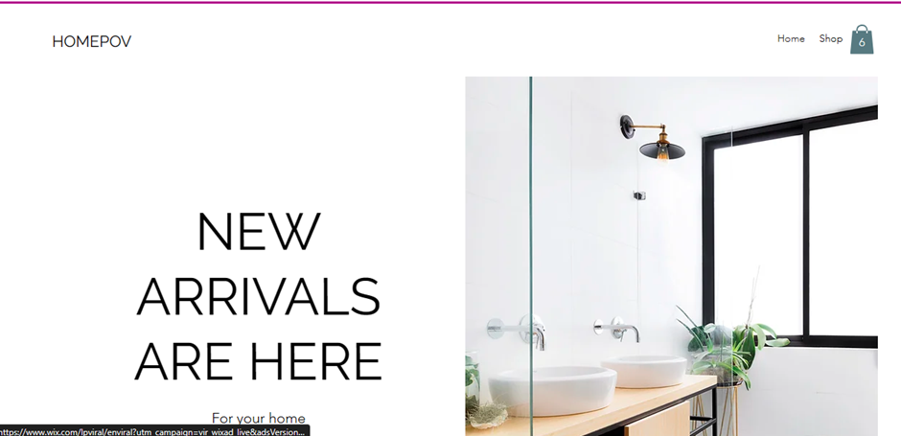
Web Page

Slide 6

Executive Summary
Provide ease in daily lives for offices, households, and individuals
Product range includes decoration, tech, kitchen accessories and more.
Target market: home improvement industry
Audience: individuals away from home for a job, and busy household/office tasks
Products cater to both households and offices
Reach customers through website and social media platforms (Facebook, Instagram)
Products designed for ease, efficiency, and cost-effectiveness
Segment audience based on needs and preferences
Website as a central hub for user-friendly shopping experience
Active social media presence on Facebook and Instagram for product promotion and engagement.

Slide 7

Business Overview
Brand Name:
HomePOV
Company Type:
Partnership of 3 individuals sharing responsibilities, liabilities, profit & loss, and management control.
Domain Name:
HomePOV | Website
Value Proposition:
Dedicated to enhancing comfort, convenience, and efficiency of homes.
Curated selection of products for lifestyle simplification, time-saving, and an enjoyable living environment.
Range includes innovative kitchen gadgets, smart home devices, organizational solutions, and lifestyle accessories.
Focus on quality, practicality, and customer satisfaction.

Slide 8
Business Overview (Cont'd):
Mission:
Commitment to curating innovative and high-quality home ease and helpful products.
Emphasis on growing presence and reach.
Goal to establish a central hub for enhanced operations, product development, and research.
Personnel:
Muhammad Sami Ullah Siddiqui: CEO/Advertising Manager
Syed Muhammad Mashood: COO/IT Specialist
Huda Nasir: PR/Social Media Specialist/SEO Manager

Slide 9
Business Overview (Cont'd)
Vision:
Aim to become the foremost name in home convenience and lifestyle enhancements.
Strive to be the go-to source for innovative, practical, and high-quality products.
Envision a future with HomePOV's workshop as a hub of creativity, innovation, and meticulous craftsmanship.
Ultimate vision is to be a catalyst for transforming houses into harmonious and efficient homes.
Brand Traits:
Embodies innovation, practicality, and high-quality craftsmanship.
Aspires to be at the forefront of home convenience and lifestyle enhancements.
Envisions a future where the workshop pushes boundaries and sets new industry standards.
Strives to transform houses into harmonious and efficient homes, maintaining a reputation for innovation.

Slide 10
Competitive Market Analysis
Competitor Analysis:
Homazing:
Broad marketing approach without targeting specific segments.
Weakness in refined marketing strategies.
Potential limitation in reaching specific audience segments.
Daraz:
Significant market presence but focuses mainly on top-selling products.
Neglects to showcase the entire range of offerings.
Potential drawback for smaller businesses in niche markets due to limited advertising of a comprehensive product catalog.

Slide 11
Competitive Market Analysis (Cont'd)
Identified Drawbacks:
Lack of targeted marketing strategy in competitors.
Focus on specific product categories, limiting visibility of diverse offerings.
Opportunities:
Untapped market requirements waiting to be explored.
Potential for businesses to intercept and excel in the industry.
Forecasting:
Analyzing market requirements to capitalize on identified opportunities.
Strategic planning to meet untapped needs and gain a competitive edge.

Slide 12
Niche Selection Strategy
Demographic Niches:
Tailoring products based on demographic characteristics.
Example: Products specifically designed for parents with young children.
Behavioral Niches:
Identifying and targeting specific behaviors or preferences.
Example: Products for individuals interested in DIY home improvement.
Targeted Audiences:
Selecting audiences based on the specific product being offered.
Example: Home office products for professionals working remotely.
Product Variation:
Adapting targeting strategies for different product categories.
Example: Customized approaches for outdoor living and home office setups.
Diversified Offerings:
- Recognizing that each product may cater to a unique niche.
- Example: Offering a range of products to meet diverse customer needs.

Slide 13
Industry reports
Growing Demand:
Rise in demand for home decoration and home care products in Pakistan.
Industry potential for business growth as it is still less explored.
Covid-19 Impact:
Rapid growth during the pandemic as people invested in making home spaces comfortable.
Increased demand due to more time spent at home.
Challenges in 2022:
Challenges due to easing COVID-19 restrictions and rising inflation.
Despite challenges, continued demand for products.

Slide 14
Industry reports (Cont'd)
Market Dynamics:
Interception opportunity due to inflation-led high prices by some businesses.
Potential for success by offering products at lower prices to attract consumers.
Government Employment Trends:
Rise in Employment Ratio:
Government reports indicate an overall increase in the employment ratio in Pakistan.
Migration of individuals to other states/cities for job opportunities.
Unexplored Market Sector:
Emerging market segment of individuals living far from families.
Specific needs for bachelors or those living alone in hostels, requiring certain feasibilities.
Business Opportunity:
Identified unexplored market sector with demand and potential for attention.
Foreseen opportunity for catering to the needs of individuals living away from families.

Slide 15
Shopping
What are your best-selling products? Our best-selling products currently include shoe racks, which customers appreciate for their space-saving design and durability. Water turbines are popular among those seeking eco-friendly energy solutions, and our electric hair straighteners have gained traction due to their advanced features and performance.
What are your worst-selling products?
Currently, our worst-selling products include the neck fan and wardrobe. Despite offering practical solutions for personal cooling and storage, these items have not gained significant traction in the market. We are actively reassessing their features and market positioning to enhance their appeal and address any potential challenges contributing to their lower sales. Our commitment to continuous improvement ensures that we adapt our inventory based on customer preferences and market dynamics.
Find products similar to yours and ask the representative his/her favorite features on products similar to yours. Exploring similar products like shoe racks, portable juicer blenders, and water turbines, representatives consistently praise their time-saving features and ease of integration into homes. Shoe racks are admired for space efficiency, portable juicer blenders for convenient health drinks, and water turbines for energy efficiency, aligning with modern eco-friendly preferences. These favored features highlight the trend of customers seeking products that save time and effortlessly enhance their home lifestyles.
How much are customers generally willing to spend on these products? Customer spending varies, but on average, there's a willingness to invest a moderate to high amount, especially for products like shoe racks and water turbines. The perceived value, durability, and functionality of these items influence customers' willingness to spend.

Slide 16
Shopping
Do customers make repeat orders of any of these products? Yes, we've observed a pattern of repeat orders, particularly for shoe racks, indicating that customers appreciate the quality and value of these items.How versatile they are. People find them useful, and positive experiences and good customer service make them keep coming back for more. It shows that our shoe racks are a hit with our customers. What do customers buy often? Customers frequently opt for practical and space-saving solutions, with items like shoe racks and portable juicer blenders being popular choices. Additionally, there is consistent interest in energy-efficient products, including water turbines, and personal grooming tools like electric hair straighteners. These preferences highlight a demand for convenience, versatility, and eco-friendly options among our customer base.
What do customers want in their homes? Customers always choose and want that product which is easier to manage and time-saving too and makes life easier at home. They prefer practical and space-saving solutions, showing a liking for items that are convenient for daily use. People are also more interested in being eco-friendly, and they're choosing options like water turbines. Personal care is also important, and products like electric hair straighteners are popular as they provide effective and easy self-care at home.
Did you cater to any bachelor or alone person and their buying habit? Yes, there's a noticeable demand from individuals living alone, especially bachelors. These customers often prioritize compact and functional products that enhance their living spaces, reflecting a preference for items tailored to their specific needs.
Do they question about quality? Customers really care about the quality of our products. They want to be sure that what they're buying is durable and just overall really good. Before they decide to buy something, they often ask about how long it will last and how well it's made. This tells us that customers want things that will stay good for a long time and meet their expectations. So, it's super important for us to make sure our products are top-notch in quality to keep our customers happy and trusting in what we offer. Providing clear info about what our products are made of and how well they work can help customers feel confident about their choices.

Slide 17
Shopping
Do they question about quality? Customers really care about the quality of our products. They want to be sure that what they're buying is durable and just overall really good. Before they decide to buy something, they often ask about how long it will last and how well it's made. This tells us that customers want things that will stay good for a long time and meet their expectations. So, it's super important for us to make sure our products are top-notch in quality to keep our customers happy and trusting in what we offer. Providing clear info about what our products are made of and how well they work can help customers feel confident about their choices.
Do they seek quality in products and what other attributes do they seek? Customers really care about quality when they buy things. Besides quality, they like products that have cool features, save space, and are energy-efficient These preferences match with today's lifestyle choices, showing that people want things that make life easier and are better for the environment. So, our focus on quality, innovation, and practicality aligns well with what customers want in their products. All of these interviewed questions and knowledge gave us an insight into people's wants and needs, their buying habits, and their preferences over price and quality. We also get to know what type of people usually buy from the stores and how far they do travel for the products.

Slide 18
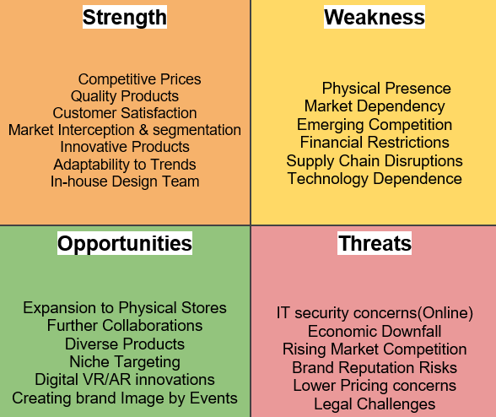
SWOT Analysis:

Slide 19
Marketing Mix of the Company:
Product:
HomePOV offers a diverse range of innovative and user-friendly products.
Products designed to simplify and enhance various daily household tasks.
Categories include smart devices, cleaning tools, organizational solutions, etc.
Aimed at creating a more efficient and enjoyable home/office environment.
Quality tech/home/kitchen accessories.
Price:
Pricing strategy considers supplier costs, competitor pricing, and perceived customer value.
Competitive pricing strategy emphasizing value for customers.
Reflecting the quality and convenience of HomePOV products.

Slide 20
Marketing Mix of the Company (Cont'd)
Place:
Products available through various channels for customer accessibility.
Channels include online sales on the official website, partnerships with e-commerce platforms.
Utilizing social media platforms (meta) for online presence and engagement.
Adopting an Omni-channel approach for a seamless customer experience.
Promotion:
Multifaceted promotion strategy for showcasing innovative household products.
Targeted advertising across online and offline channels.
Compelling visuals and informative content highlighting the value of HomePOV offerings.
Active engagement on social media platforms, fostering a community connection.
Interactive content, user testimonials, and expert tips for streamlining daily household tasks.
Collaborations with influencers to amplify the reach of HomePOV's products

Slide 21
Products and Offers:
Product Characteristics:
HomePOV offers unsought and convenience products, introducing unique items to the market.
Particularly targets individuals living alone with products unknown to them initially.
Focus on reasonable pricing to make these products attractive and convenient for purchase.
Targeted Niches:
Demographic Niches:
Parents with young children/Newly Wed.
Home Office Setup.
DIY Home Improvement Enthusiasts.
Outdoor Living.

Slide 22

Products and Offers (Cont'd)
Existing Product - LED Lamp:
Attractive and eye-catching design.
Key Features:
Portable and Rechargeable.
Crystal-made lamp with elegant color shining.
Provides hours of lighting.
Pricing Strategy:
Target Price for the LED Lamp: Rs 1800/unit.
Supplier Cost of Product: Rs 1400.
Total Cost per Unit: Rs 1550.
Profit Margin per Unit: Rs 250/unit.

Slide 23
Marketing Plan and Operations:
Understanding the market segment for our products
Demographics: Primarily aged 18-35, located in different states/cities, diverse educational backgrounds, with varying income levels.
Preferences: Seek convenience, space-saving solutions, and tech-savvy products.
Buying Power: Price-sensitive market, prioritizing affordability and value for money.
Insights: Analyze buying behavior, online presence, and preferences through surveys and feedback.
Target Market/Area: Identify specific regions with a higher concentration of the target demographic.
Market Research: Conduct competitor analysis and adapt strategies based on feedback.
Communication Channels: Utilize social media and local events for effective advertising and engagement.
Adaptability: Stay dynamic, responsive to changing preferences, and establish a feedback loop for continuous improvement.

Slide 24
Which Channel Is Best For You?
Marketing Strategy Evolution:
Product Introduction:
Provide efficient products for daily life improvement.
Concerns about customer awareness and affordability.
Paid Marketing Phase:
Utilized Meta (Facebook and Instagram) for paid marketing.
Initial focus: Create awareness about product existence.
Drive traffic to the official website and social media pages.
Traffic Generation:
Continued paid marketing until sufficient traffic was achieved.
Goal: Make consumers aware of products.
Product Promotion at Competitive Prices:
Shifted to paid marketing to promote in-demand products.
Emphasized offering the most reasonable prices, lower than competitors.
Channels: Website, social media pages, and WhatsApp Business.
Dedicated social media personnel handled customer queries.

Slide 25
Which Channel Is Best For You?
5. Consumer Trust Building through Organic Marketing:
Transitioned to organic marketing strategy.
Collaborated with Instagram influencers for authenticity.
Influencers created content using HomePOV products.
Content shared on influencers' social media, building trust and credibility.
Objective: Establish a significant trust-building relationship with customers.
6. Purpose of Organic Marketing:
Gain consumer trust after achieving initial sales.
Leverage influencer collaborations for a more genuine and trustworthy brand image.
Expand outreach by tapping into influencers' follower base.

Slide 26
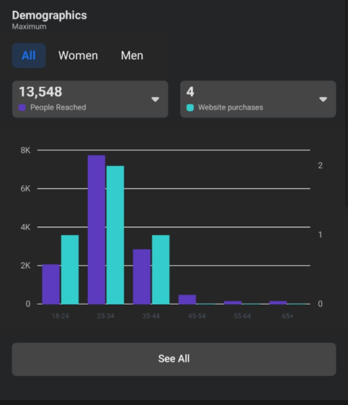
Demographics:

Slide 27
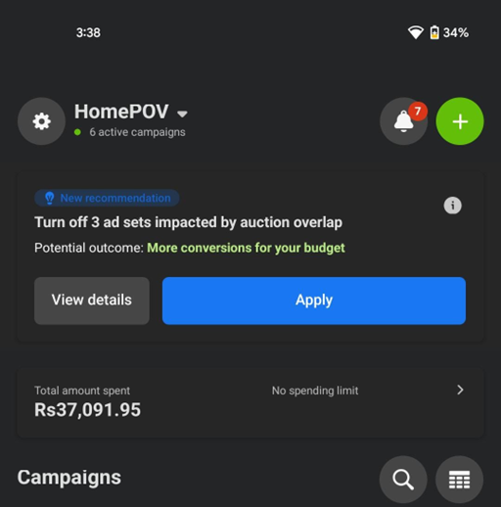
Ad Spending:

Slide 28
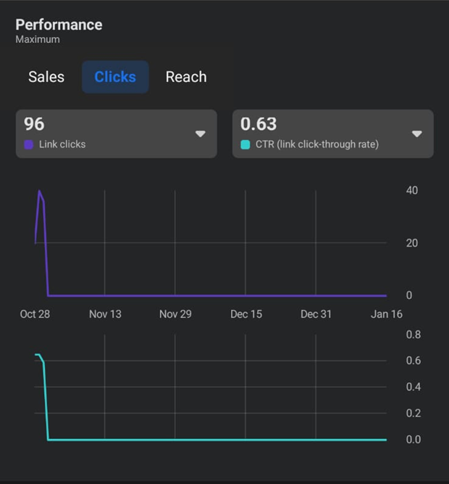
Performance:

Slide 29


